Slide 1
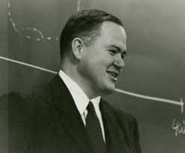
Frequency transformation using matlab | the same person who brought you boxplots
Julius Welzel
Kiel, 29. Januar 2021
John W. Tukey

Slide 2
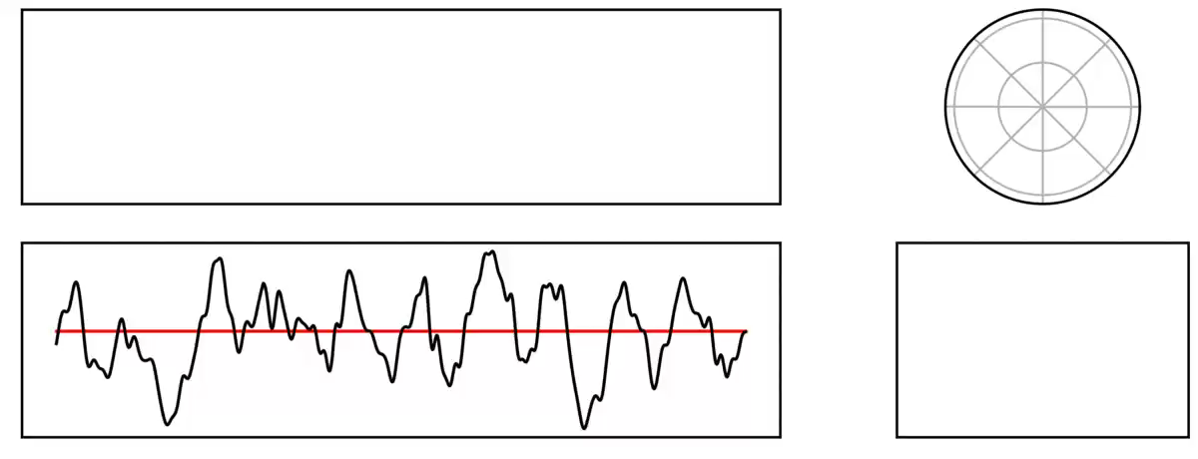
What and why?
Twitter @Tomdonoghue

Slide 3
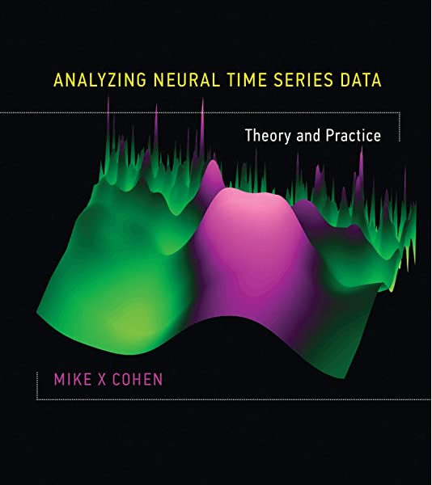
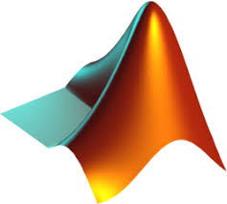
How?

Slide 4
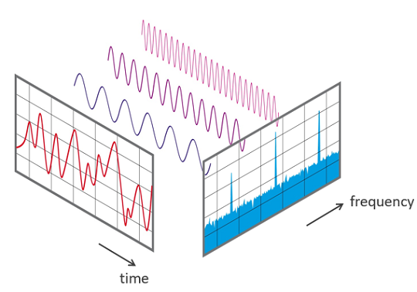
Goals!
What is the time domain?
What is the frequency domain?
How to transform in Matlab
MatLab in general

Slide 5

Basics
Units
Time → s [s]
Frequency → Hz [1/s]
Amplitude → [a.u., e.g. mV]

Slide 6
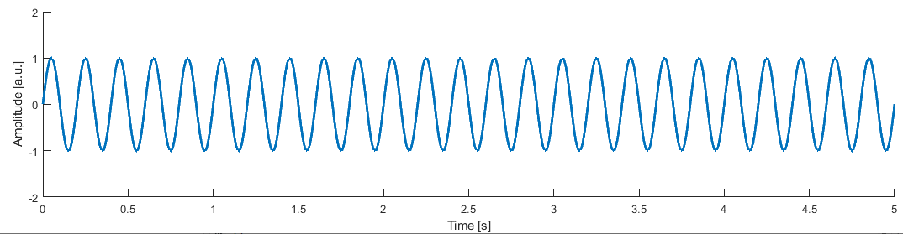
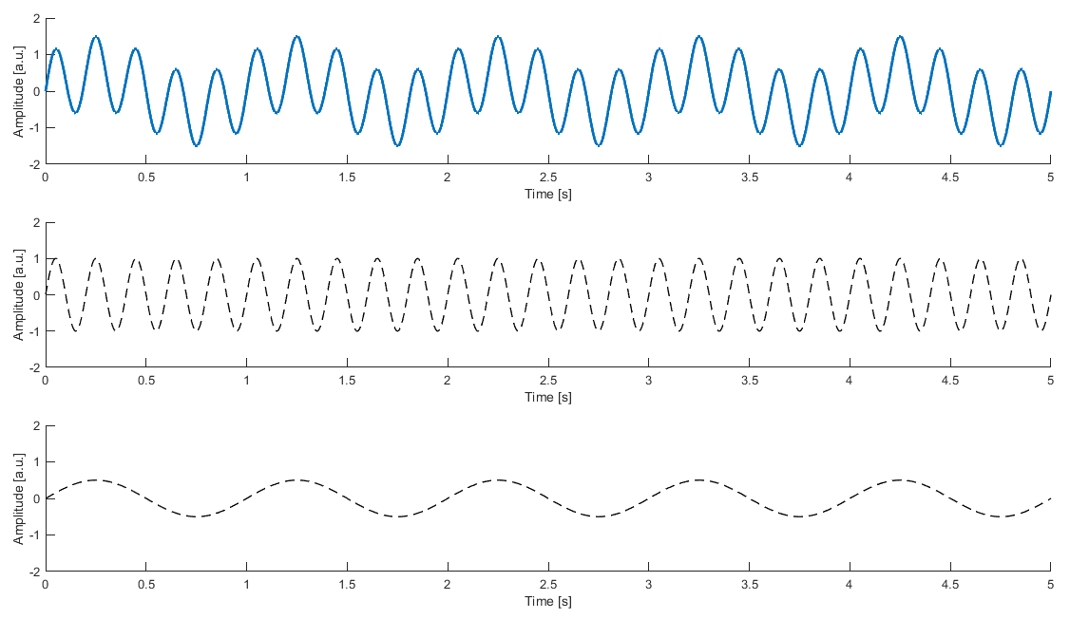
Time domain

Slide 7
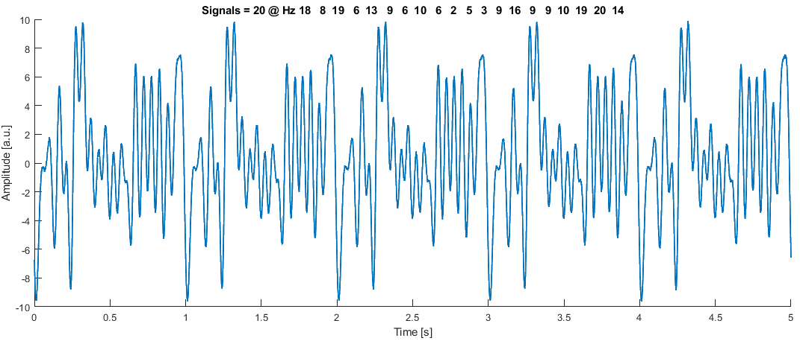
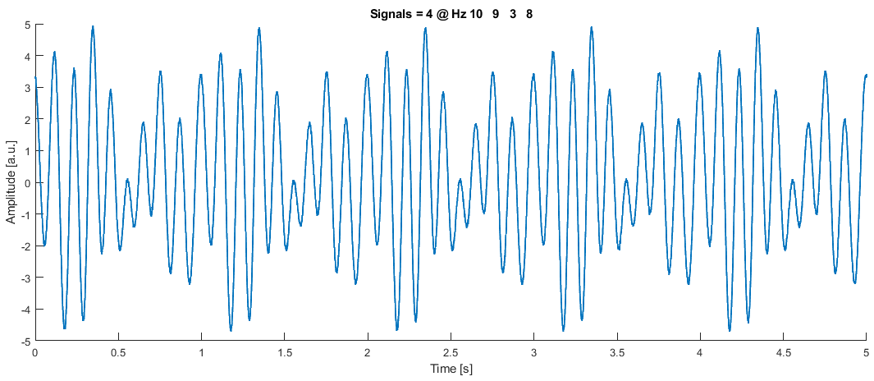
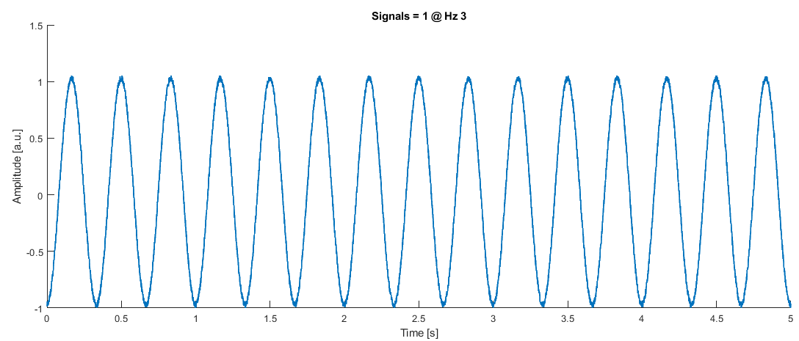
Multiple signals

Slide 8
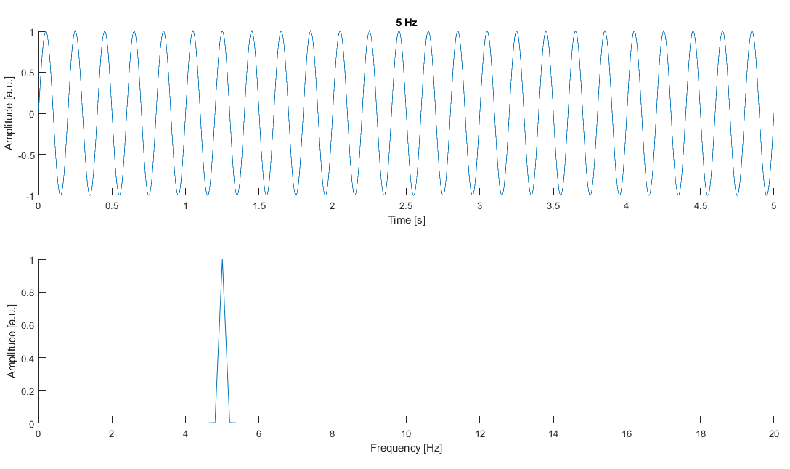
Frequency domain

Slide 9
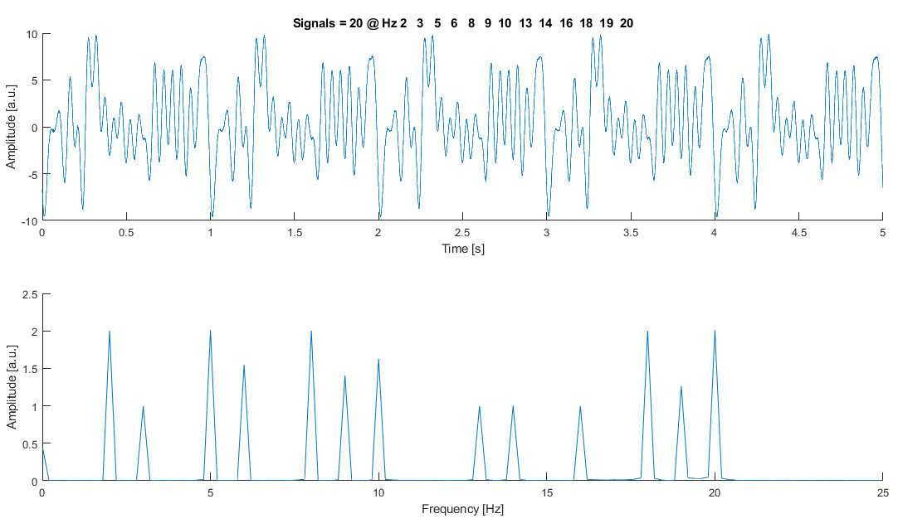
Easy to seperate

Slide 10
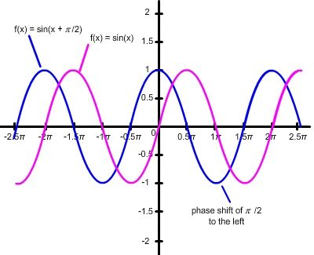
What and why?
Twitter @Tomdonoghue

Slide 11
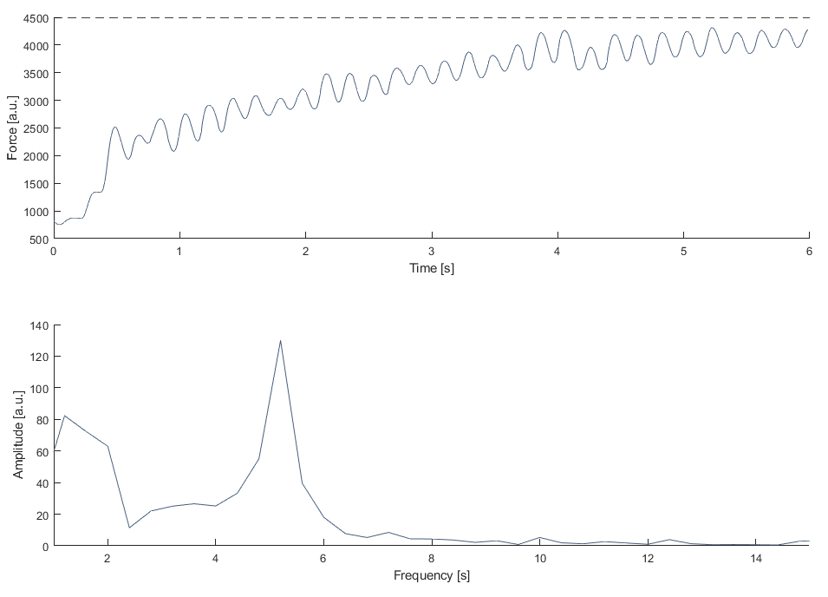
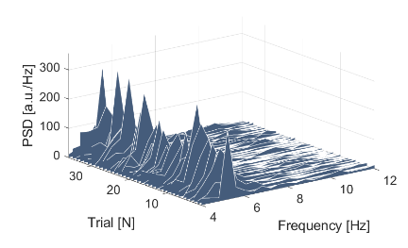
Real life example
Tremor
Voluntary movement
Features:
Max. amplitude
Width
Power-Spectral-density (PSD)

Slide 12
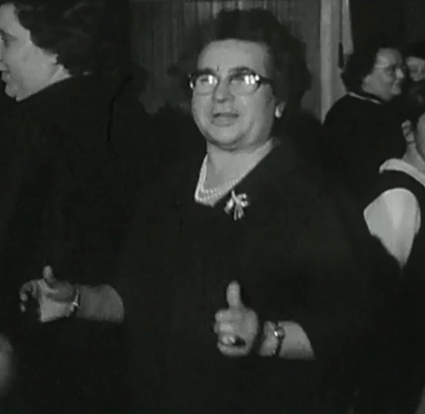
Vielen Dank für die Aufmerksamkeit

